Slide 1
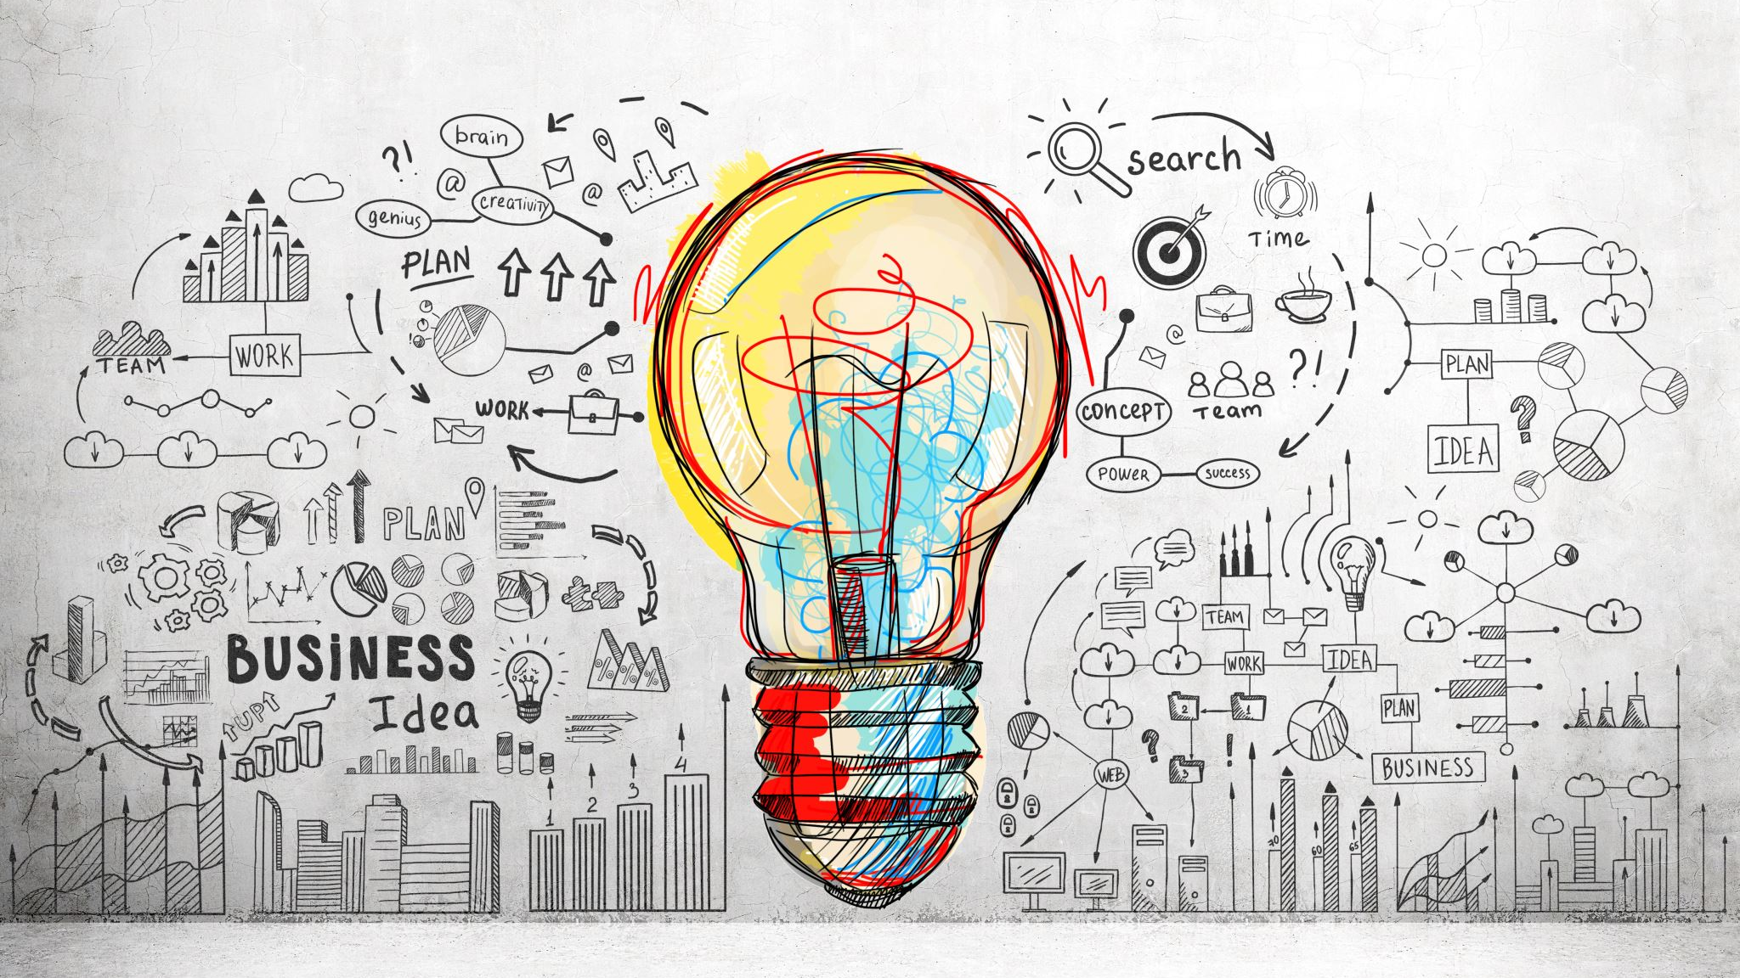
Emotional control
the skill of managing emotions

Slide 2
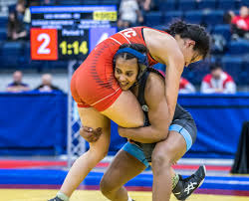
emotions
Emotions are a natural and fundamental part of being human, and they can have a powerful impact on your performance as an athlete. They are the feelings and reactions that arise in response to various situations, events, or thoughts. Emotions can range from happiness, excitement, and confidence to fear, anger, and anxiety.

Slide 3
Emotional awareness
Understanding and managing your emotions is crucial for your success in sports. Positive emotions, like excitement and confidence, can boost your motivation and performance. They can help you stay focused, energized, and resilient, especially when facing challenging situations. On the other hand, negative emotions, such as fear or frustration, can hinder your performance if not managed effectively. They may lead to distraction, self-doubt, or even physical tension that can affect your coordination and skills.

Slide 4
Setting the foundation

Slide 5
Nutrition
Incorporating a balanced diet with a variety of whole foods, including fruits, vegetables, lean proteins, whole grains, healthy fats, and adequate hydration can provide the nutrients and energy your body and brain need to better manage stress and anxiety.

Slide 6
sleep
Sleep is a foundational component of mental well-being. It supports emotional regulation, stress hormone balance, cognitive function, and physical relaxation, all of which contribute to the reduction of stress and anxiety in your daily life. Prioritizing good sleep habits can be an effective strategy for managing stress and anxiety.

Slide 7
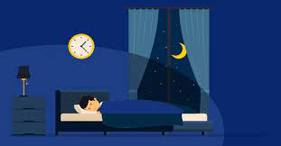
Guidelines for sleep
-high quality and high quantity
-8 hours per night
-cool
-dark room
-quiet
-no use of personal devices
-naps: 12 hours from mid point of nocturnal sleep cycle

Slide 8
Steps to emotional control
SELF AWARENESS
SELF REGULATION
ROUTINES
SUPPORT

Slide 9
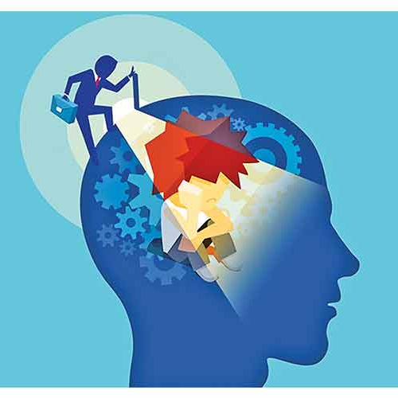
Self awareness
The first step is for athletes to become aware of their emotions. They should recognize how they feel in different situations, both in training and competition. This involves identifying triggers for certain emotions, such as anxiety, anger, or frustration. Self-awareness helps athletes understand their emotional responses and lays the foundation for managing them effectively.

Slide 10
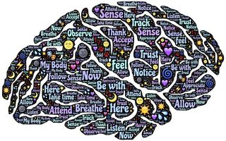
Self regulation
Once athletes are aware of their emotions, they can employ various strategies to regulate them. These strategies may include deep breathing exercises, visualization, progressive muscle relaxation, or mindfulness meditation. These techniques can help athletes stay calm, focused, and in control during high-pressure situations.

Slide 11
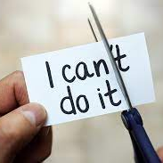
Self Regulation positive self-talk
Positive self-talk is a cognitive skill that can be honed through practice. It's a valuable tool for managing stress and anxiety, enhancing self-confidence, and optimizing performance in various domains, from sports to academics and professional endeavors. By cultivating a habit of positive self-talk, individuals can build mental resilience and navigate stressors with greater ease and effectiveness.
Shifts perspective
Improves focus and concentration
Reduces catastrophizing
Supports goal achievement

Slide 12
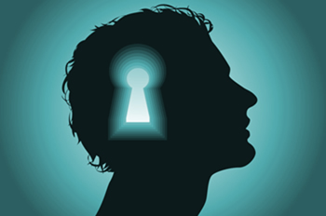
Self regulation visualization
Visualization is a skill that improves with practice. Whether you're an athlete, a performer, a student, or anyone striving to achieve goals and reduce anxiety, incorporating visualization techniques into your routine can be a valuable tool for success.

Slide 13
Tips for visualization
Consistency: Practice visualization regularly, ideally incorporating it into your daily routine. Consistency enhances its effectiveness over time.
Emotion and Sensation: Engage your emotions and physical sensations during visualization. Feel the excitement, confidence, and satisfaction associated with success. This makes the visualization more powerful.
Realism: Be as detailed and realistic as possible in your imagery. The more vivid your mental scenario, the more beneficial it is.
Positive Focus: Keep your visualizations positive. Instead of dwelling on potential mistakes or failures, concentrate on successful outcomes and your ability to overcome challenges.
Combine with Affirmations: Pair your visualization with positive affirmations or self-talk to reinforce the mental message of success.

Slide 14
Self regulation breathing Techniques
Incorporating breathing techniques into your pre-performance, intra-performance, or daily routines can be a valuable strategy for managing stress and anxiety, optimizing focus, and enhancing overall performance. These techniques are versatile and can be adapted to various situations, making them a valuable tool for athletes, students, professionals, and anyone seeking to perform at their best under pressure.

Slide 15
Breathing techniques
2 in, 1 out
Box Breathing

Slide 16
routine
Developing daily routines and pre-performance routines can help athletes prepare mentally and emotionally for competitions. These routines can include activities like visualization, positive self-talk, and physical warm-up exercises. Routines provide a structured approach to managing emotions and ensure athletes are in the right mindset when it's time to perform.

Slide 17
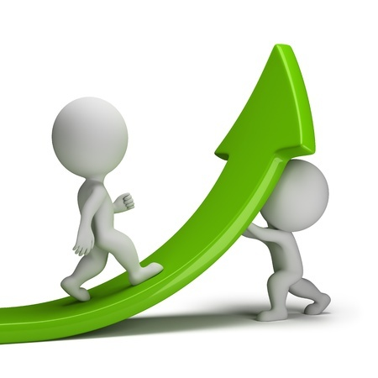
support
Athletes should not hesitate to seek support from sports psychologists, coaches, or mentors who can provide guidance on emotional control. They can also undergo specific training in sports psychology to enhance their emotional management skills. Having a support system in place can make a significant difference in helping athletes cope with the pressures of competition.

Slide 18
Talk it out
Talking through your thoughts, feelings, and emotions is a valuable aspect of mental health self-care. It promotes emotional release, provides support, enhances problem-solving skills, and fosters a sense of connection and understanding. Whether through conversations with friends and family or with the guidance of a mental health professional, talking can be a critical component of managing stress and anxiety effectively.

Slide 19
Emotional control
Emotional control doesn't mean suppressing or ignoring your emotions; it means recognizing them, acknowledging their presence, and learning how to respond to them in a way that benefits your performance. By developing emotional awareness and regulation skills, you can harness the power of your emotions to improve your athletic abilities, cope with pressure, and stay mentally resilient in the face of adversity.

Slide 20
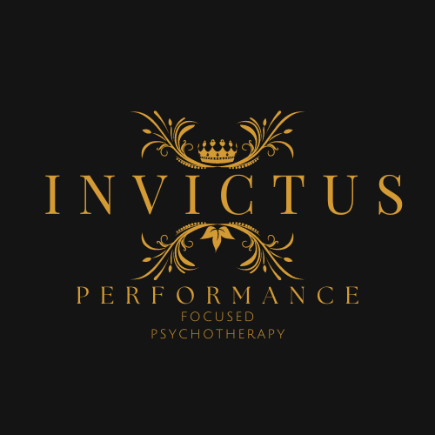
Contact
Adam (AJ) Zeglen
Owner/Psychotherapist
Invictus Performance Focused Psychotherapy
105 Fort Whyte Way #100
Oak Bluff, MB R4G 0B1
ajzeglen@invictuspfp.com, (204) 770-2059

